Slide 1
Exploratory Data Analysis
Week 5 Session 2
Lecture and Slides by Jazzie R. Jao | jazzie.jao@dlsu.edu.ph

Slide 2
Outline
In this session, we are going to look at different techniques of EDA:
Univariate Analysis
Bivariate Analysis
Multivariate Analysis
Categorical Data Analysis
Missing Data Analysis
Time Series EDA
EDA and Feature Engineering

Slide 3
Preliminaries
To illustrate the EDA techniques, we will use the Sleep Health Lifestyle Dataset 🧟🤕
Therefore, you should:
Download the dataset from our repository.
Create new notebook in your google colab workspace.
Upload the dataset.
or…
Go to our course repository and follow the lecture with the uploaded EDA notebook.

Slide 4
Outline
In this session, we are going to look at different techniques of EDA:
Univariate Analysis
Bivariate Analysis
Multivariate Analysis
Categorical Data Analysis
Missing Data Analysis
Time Series EDA
EDA and Feature Engineering

Slide 5
Univariate Analysis
Analyze a single variable, exploring its distribution and key statistics.
summary statistics (mean, median, mode, variance, etc.).
histograms and boxplots.
skewness and kurtosis based on the plots.
outlier detection and discuss how they could impact the analysis.

Slide 6
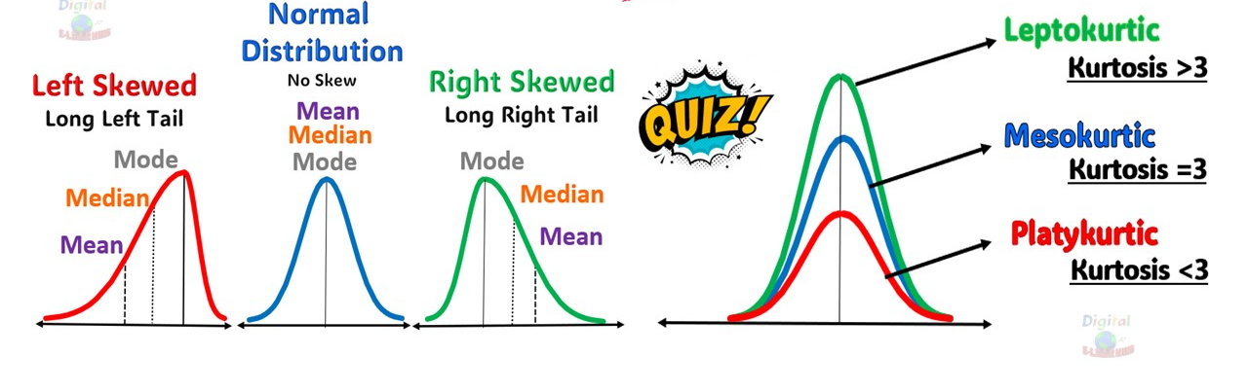
Univariate Analysis
Analyze a single variable, exploring its distribution and key statistics.

Slide 7
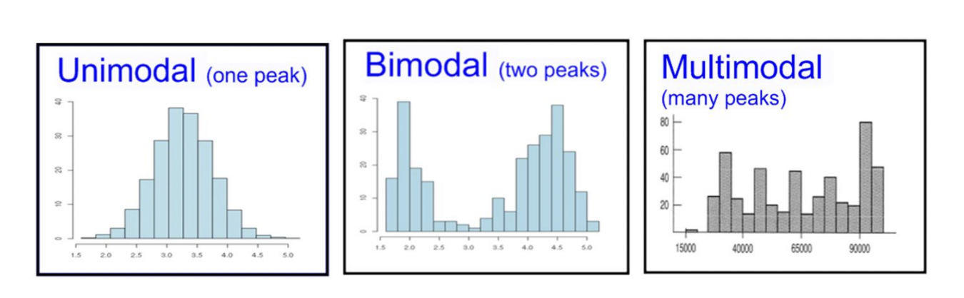
Univariate Analysis
Analyze a single variable, exploring its distribution and key statistics.

Slide 8
Outline
In this session, we are going to look at different techniques of EDA:
Univariate Analysis
Bivariate Analysis
Multivariate Analysis
Categorical Data Analysis
Missing Data Analysis
Time Series EDA
EDA and Feature Engineering

Slide 9
Bivariate Analysis
Explore relationships between two variables.
scatter plot to assess the correlation between numerical variables and compute correlation coefficients.
heatmap of correlations for multiple variables.
for categorical vs. numerical data, use box plots or violin plots to compare distributions.

Slide 10
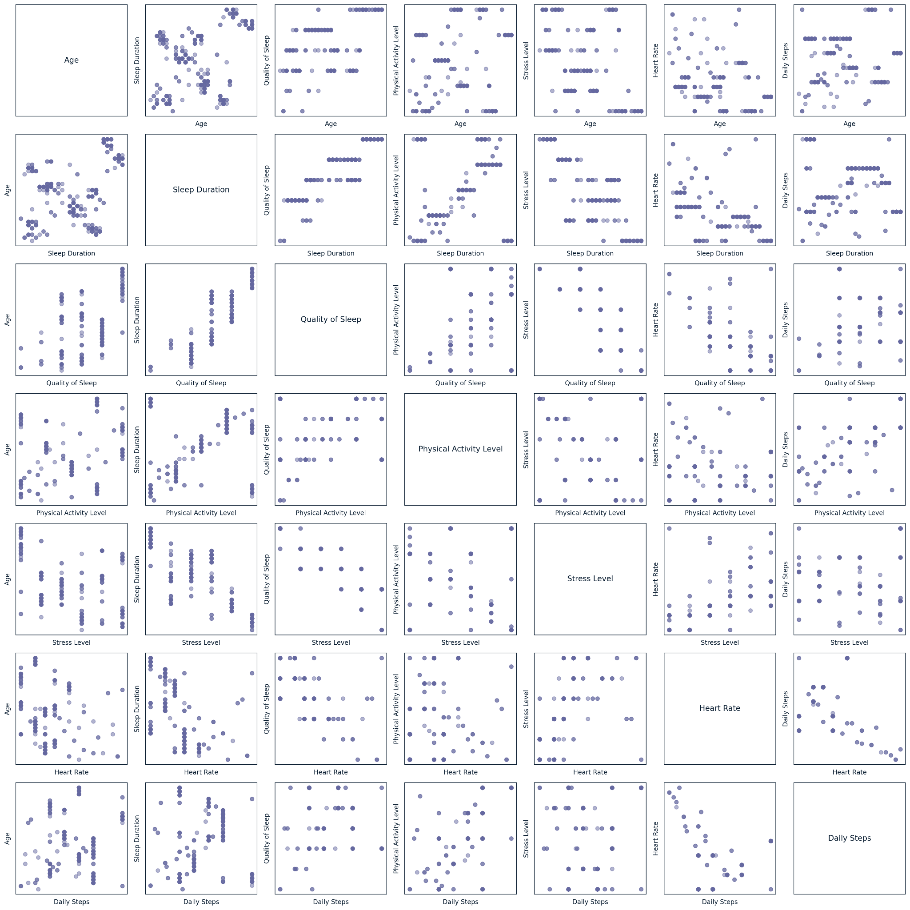
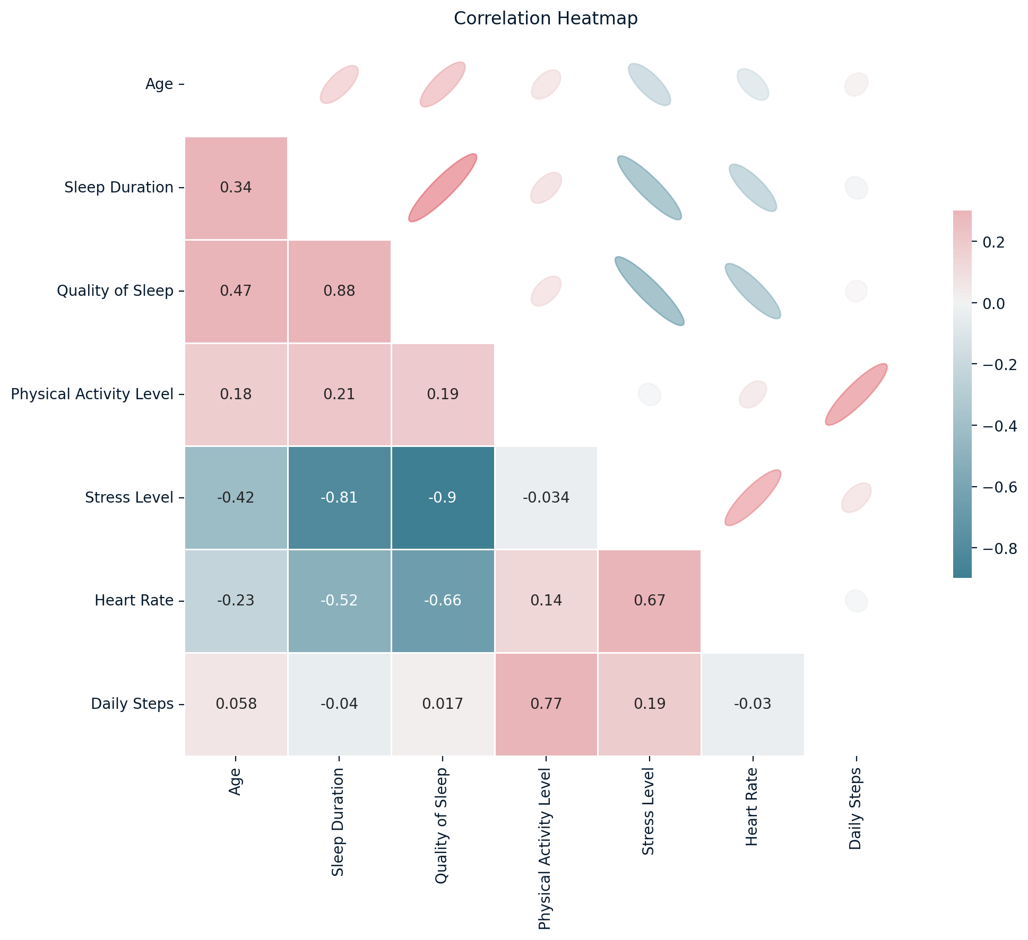
Bivariate Analysis
Explore relationships between two variables.

Slide 11
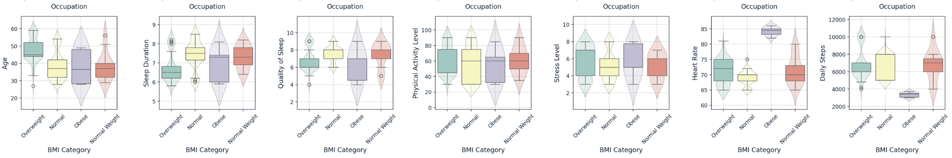
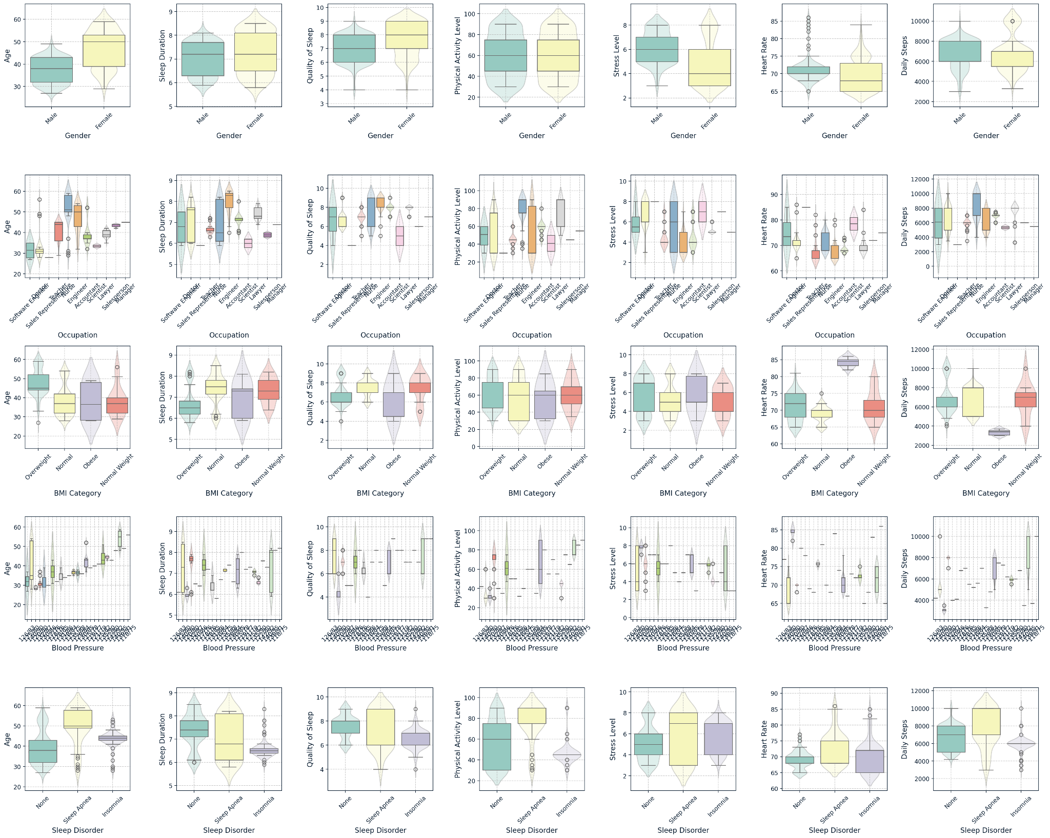
Bivariate Analysis
Explore relationships between two variables.

Slide 12
Outline
In this session, we are going to look at different techniques of EDA:
Univariate Analysis
Bivariate Analysis
Multivariate Analysis
Categorical Data Analysis
Missing Data Analysis
Time Series EDA
EDA and Feature Engineering

Slide 13
Multivariate Analysis
Examine relationships between three or more variables.
Colored scatter plots to visualize trends based on an additional categorical variable.
Principal Component Analysis (PCA) and explain the results.

Slide 14
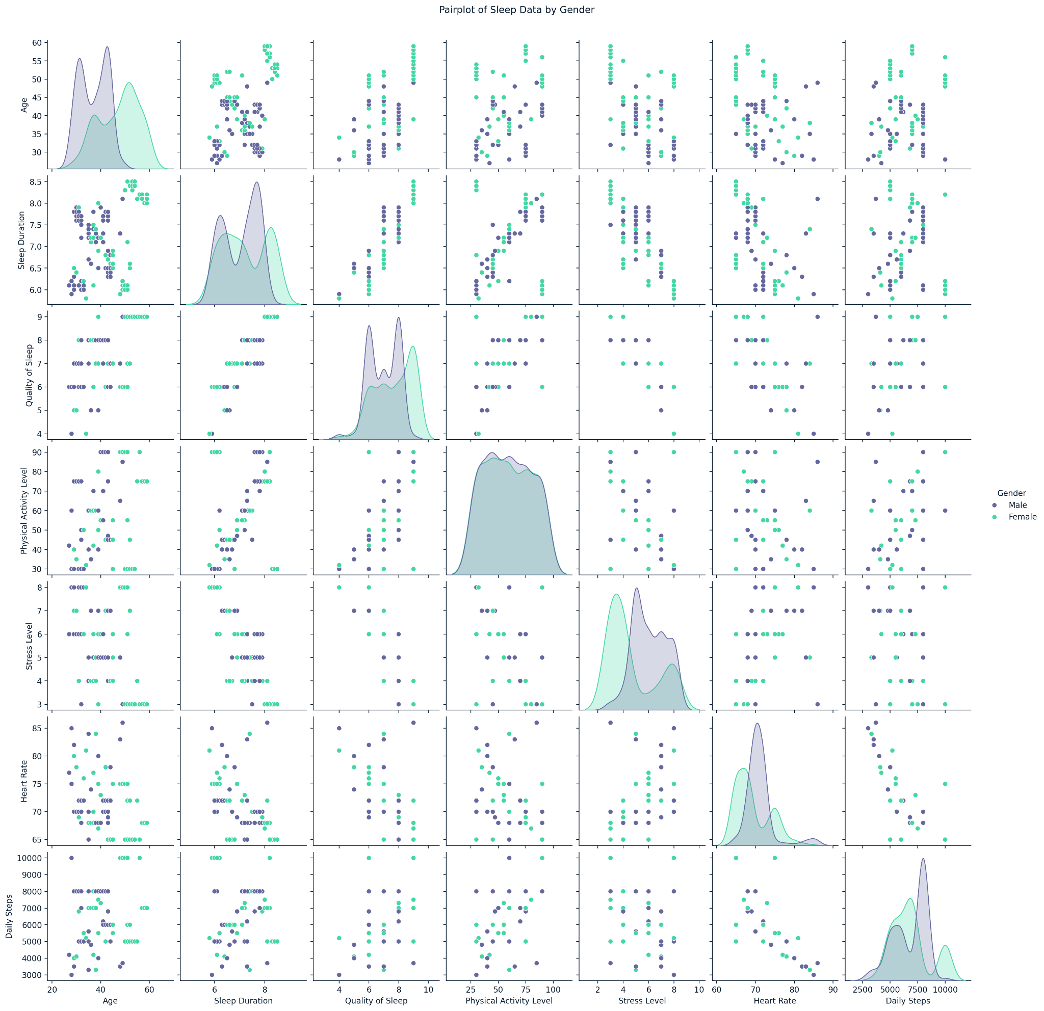
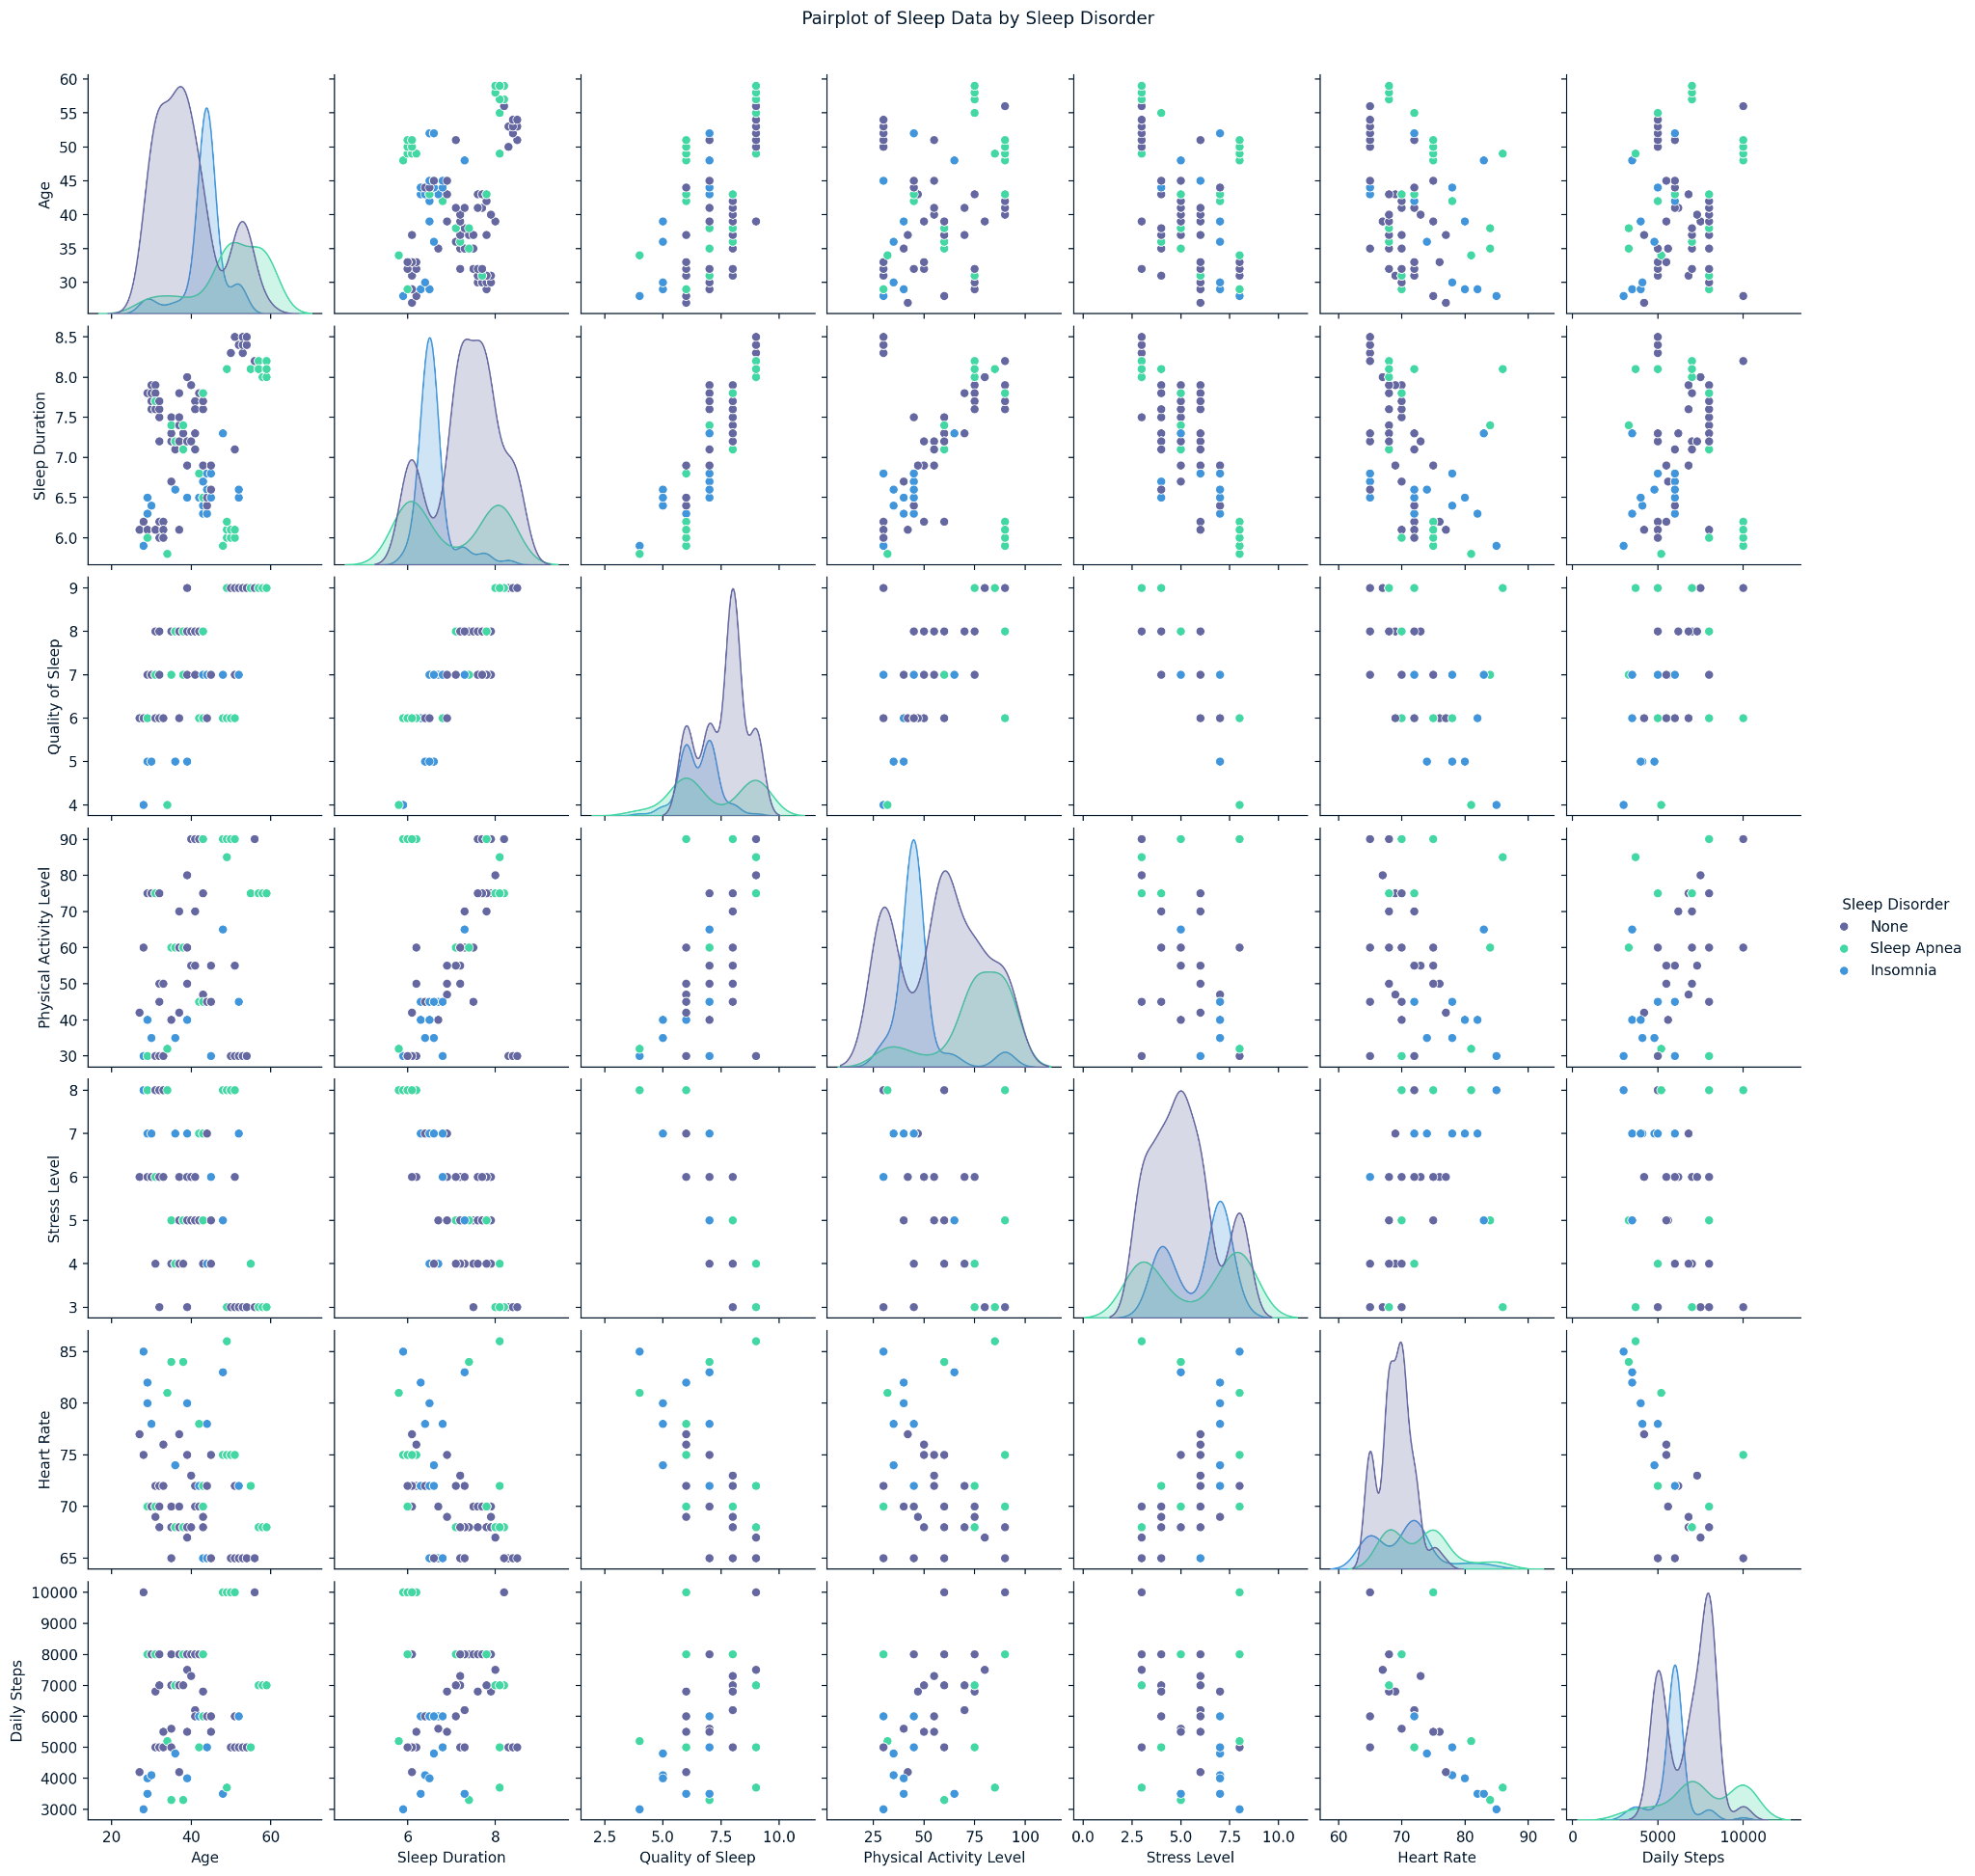
Multivariate Analysis
Examine relationships between three or more variables.

Slide 15
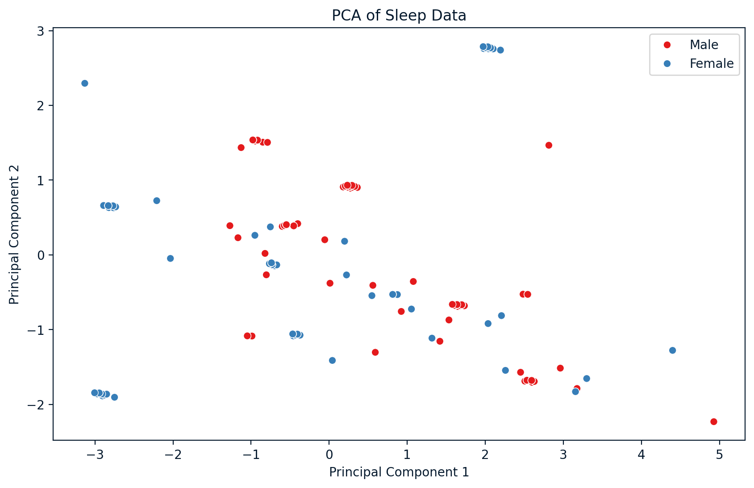
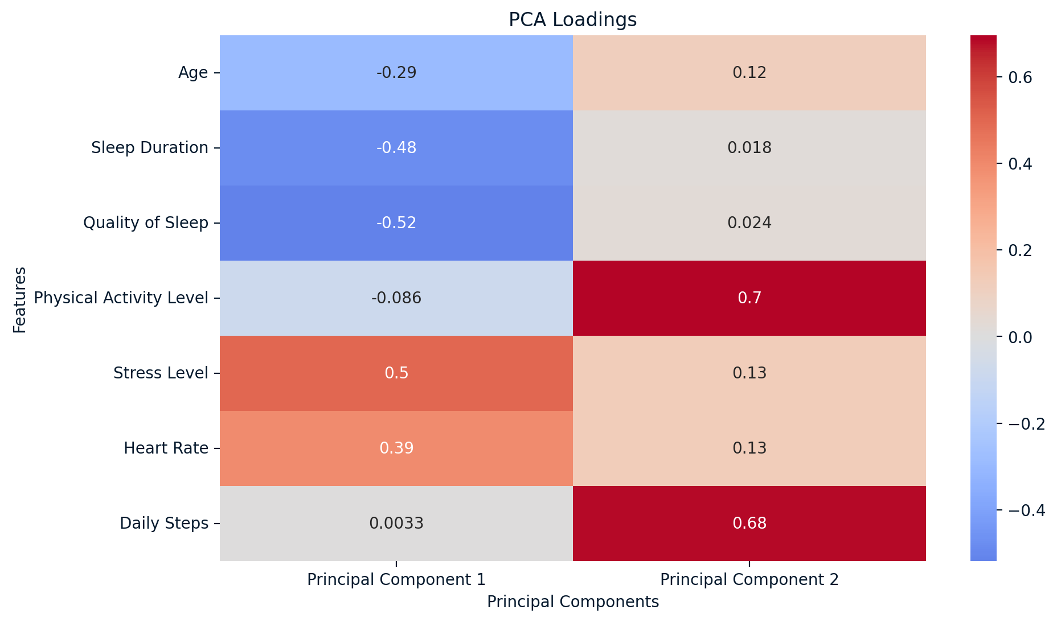
Multivariate Analysis
Examine relationships between three or more variables.
Notes:
PCA is a dimensionality reduction technique that summarizes the information in a dataset with many variables by transforming them into a smaller set of uncorrelated principal components. These components capture the maximum variance in the data while simplifying its structure.

Slide 16
Multivariate Analysis
Examine relationships between three or more variables.
PC1 appears to be influenced mostly by stress level, heart rate, and sleep-related features (sleep duration and quality), with negative loadings for sleep-related features and positive loadings for stress and heart rate. PC1 may represent a component that differentiates individuals based on stress and physiological factors like heart rate and sleep behavior.
PC2 is heavily influenced by physical activity level and daily steps, both of which show high positive loadings.
Notes:
In this PCA analysis, instead of looking at each feature independently (like age or sleep duration), PCA condenses the influence of multiple variables into two principal components (PC1 and PC2) that explain the majority of variance in the dataset. This enables you to analyze a multivariate dataset in a way that’s easier to interpret, without sacrificing too much information.

Slide 17
Multivariate Analysis
Examine relationships between three or more variables.
Dimensionality Reduction for Modeling: In machine learning or predictive modeling, datasets with many correlated variables (multicollinearity) can cause problems for models such as linear regression or logistic regression. PCA can help by transforming the data into independent components, reducing multicollinearity, and improving model performance.
if you are building a predictive model for well-being or health outcomes, you might not need to include all original variables like sleep duration, stress level, and physical activity. Instead, you could use the principal components (which are combinations of these variables) as the input features for a more efficient model.
Notes:
In this PCA analysis, instead of looking at each feature independently (like age or sleep duration), PCA condenses the influence of multiple variables into two principal components (PC1 and PC2) that explain the majority of variance in the dataset. This enables you to analyze a multivariate dataset in a way that’s easier to interpret, without sacrificing too much information.

Slide 18
Outline
In this session, we are going to look at different techniques of EDA:
Univariate Analysis
Bivariate Analysis
Multivariate Analysis
Categorical Data Analysis
Missing Data Analysis
Time Series EDA
EDA and Feature Engineering

Slide 19
Categorical Data Analysis
Explore and visualize categorical variables.
frequency tables for categorical variables.
visualization of categories using bar plots or pie charts.
Chi-Square tests for independence between categorical variables.
Notes:
The Chi-Square test assesses whether there is a significant association between two categorical variables. The null hypothesis (H₀) is that there is no association between gender and occupation, meaning the distribution of occupations is independent of gender. The alternative hypothesis (H₁) is that there is a significant association between gender and occupation.

Slide 20
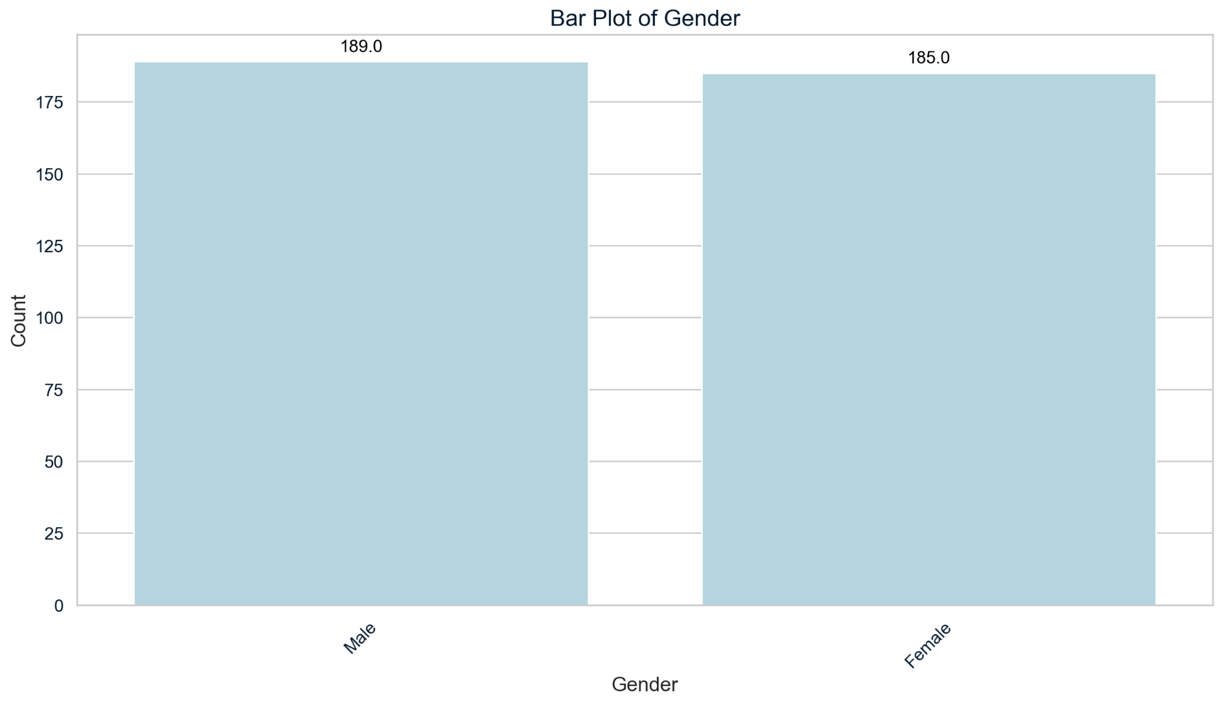
Categorical Data Analysis
Explore and visualize categorical variables.

Slide 21
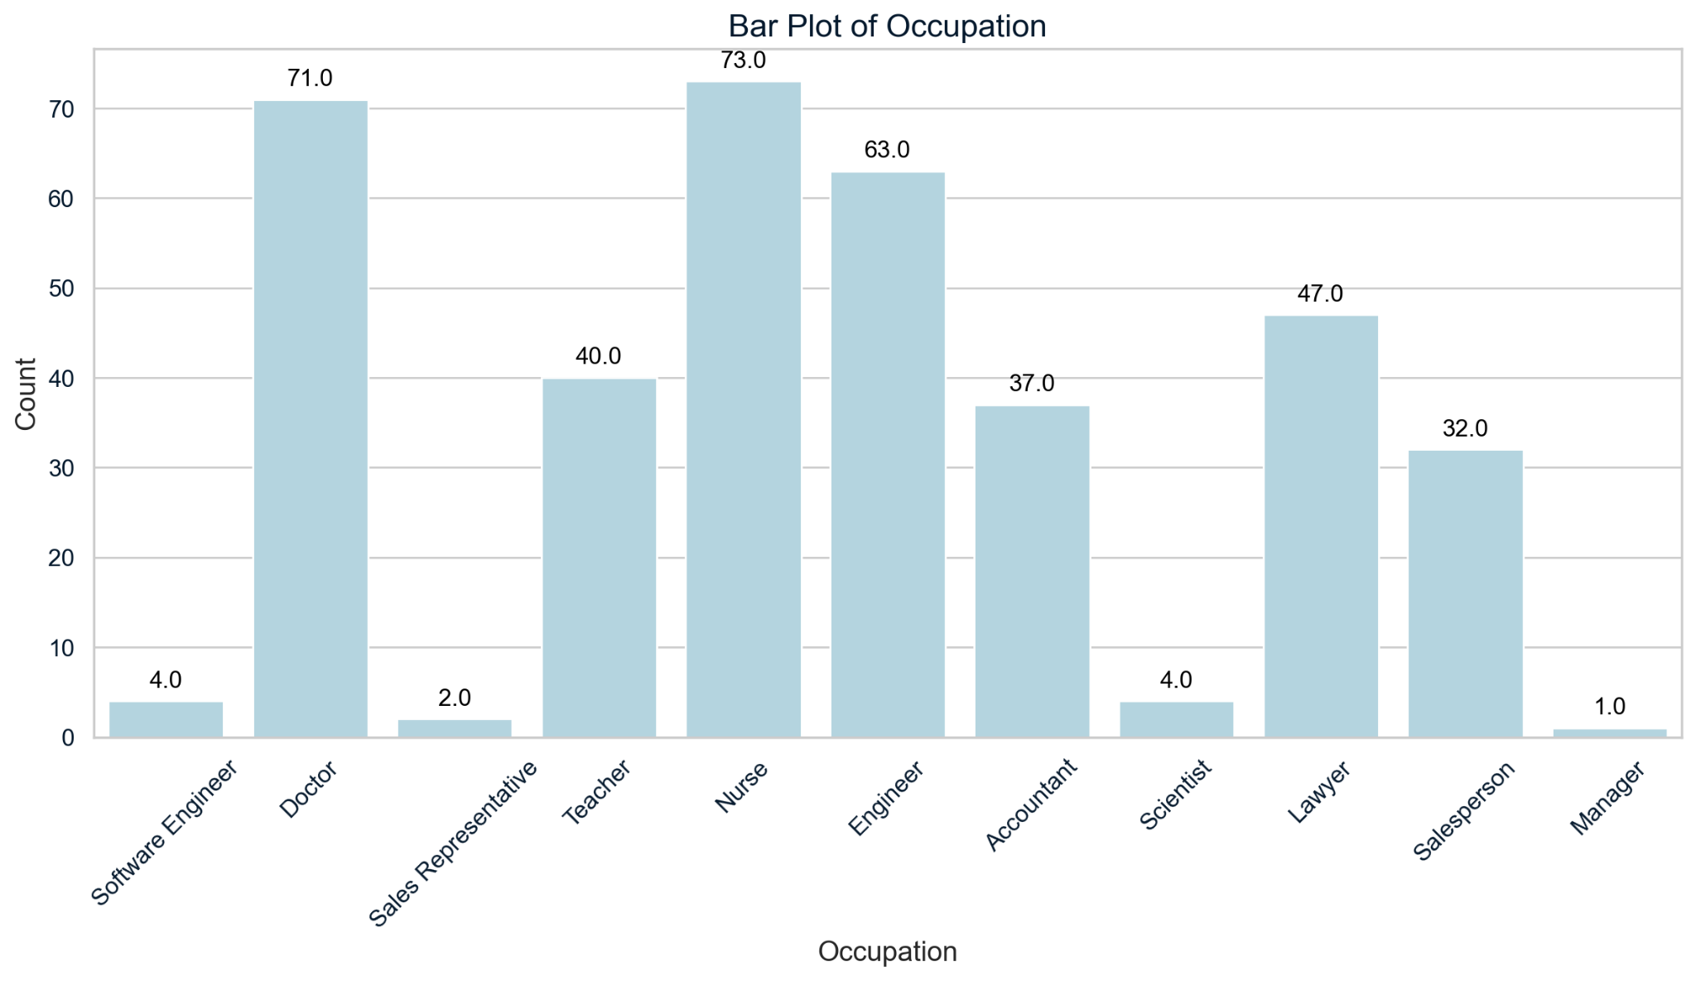
Categorical Data Analysis
Explore and visualize categorical variables.

Slide 22
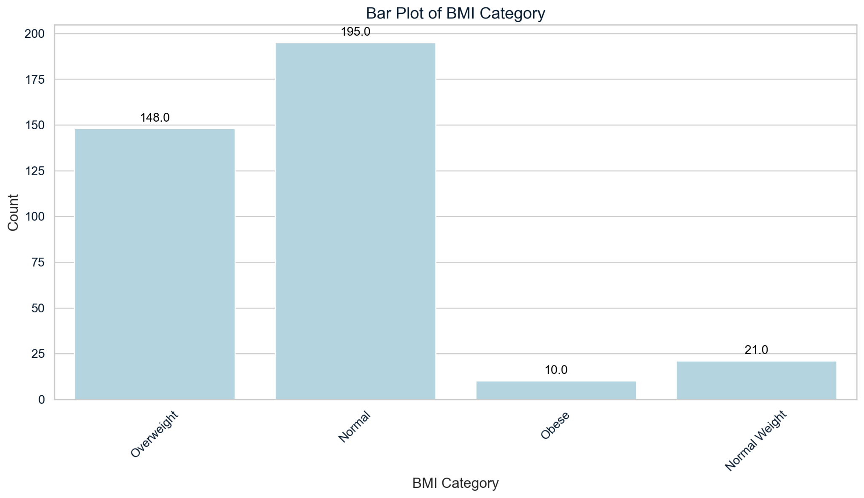
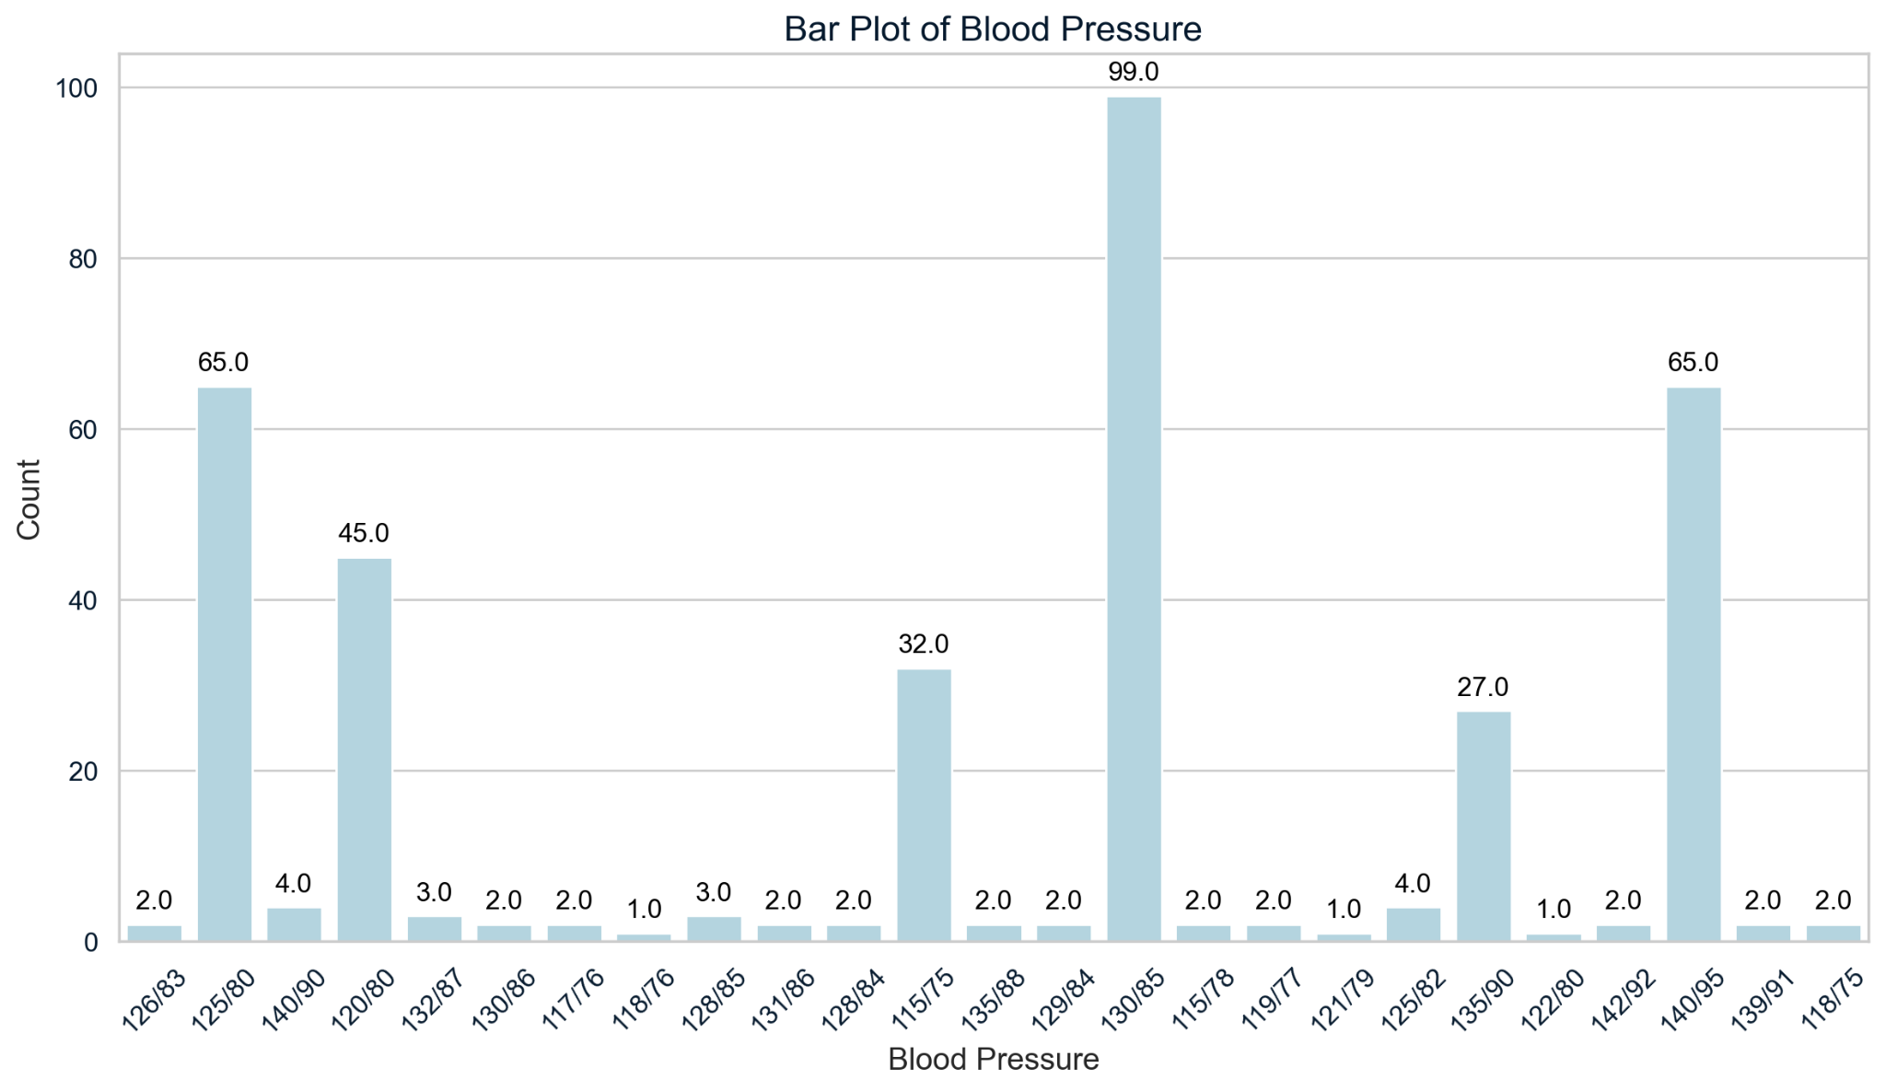
Categorical Data Analysis
Explore and visualize categorical variables.

Slide 23
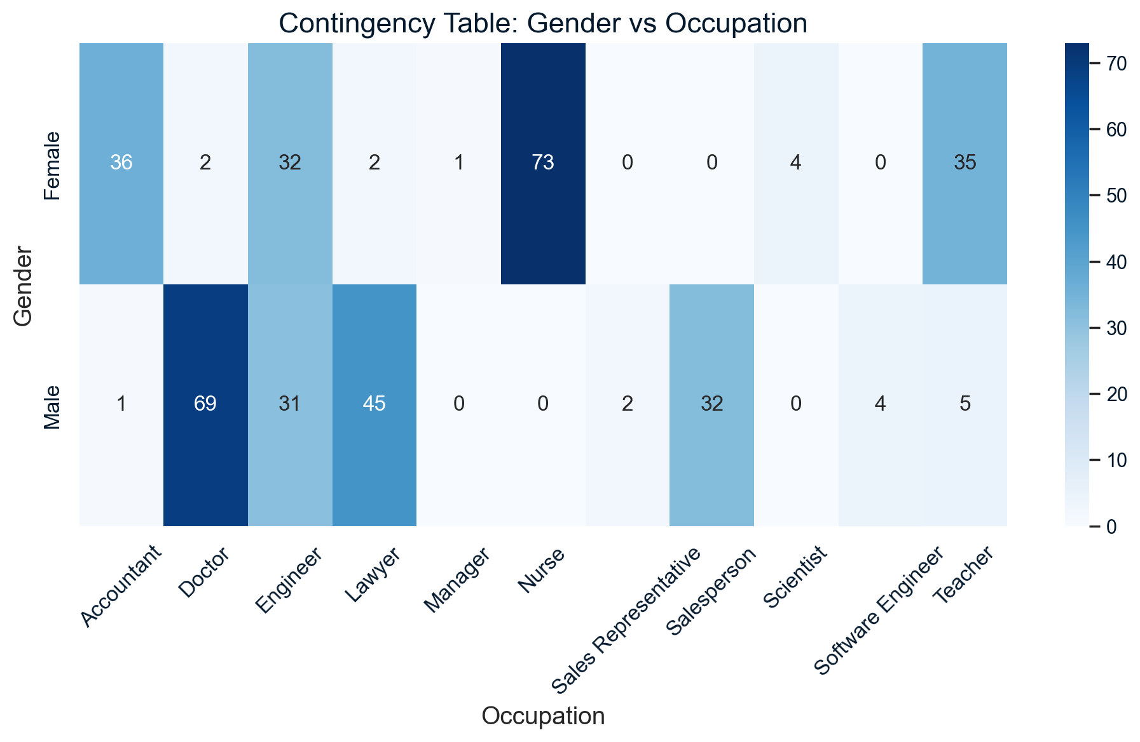
Categorical Data Analysis
Explore and visualize categorical variables.
Notes:
The Chi-Square test assesses whether there is a significant association between two categorical variables (in this case, gender and occupation). If the test returns a significant p-value (typically < 0.05), it means that the observed differences in occupation between males and females are unlikely to have occurred by chance, and thus, gender is associated with occupation. A non-significant p-value would mean there is no evidence to reject the null hypothesis, suggesting gender and occupation are independent.

Slide 24
Outline
In this session, we are going to look at different techniques of EDA:
Univariate Analysis
Bivariate Analysis
Multivariate Analysis
Categorical Data Analysis
Missing Data Analysis
Time Series EDA
EDA and Feature Engineering

Slide 25
Missing Data Analysis
Explore and handle missing data in the dataset.
missing data patterns using heatmaps.
strategies to handle missing data (e.g., imputation, deletion).
methods to handle missing data and choice justification

